Slide 1

Amazon Sales Report
By CHIRAG M V

Slide 2
Amazon Sales Analysis: Unveiling Trends Across Timeframes
Welcome to the Amazon Sales Analysis presentation, where we delve into the intricacies of sales data on one of the world's largest online retail platforms.
Today, we'll explore the dynamic landscape of Amazon sales, dissecting trends and uncovering insights at three crucial timeframes: per month, per year, and per yearly month.
By delving into these different timeframes, we aim to provide a comprehensive understanding of sales patterns, consumer behavior, and market dynamics within the Amazon ecosystem.
Let's embark on this journey to unravel the story behind the numbers and equip ourselves with actionable insights to optimize our strategies and drive growth on Amazon.

Slide 3
Sales trend: Month-wise

Slide 4
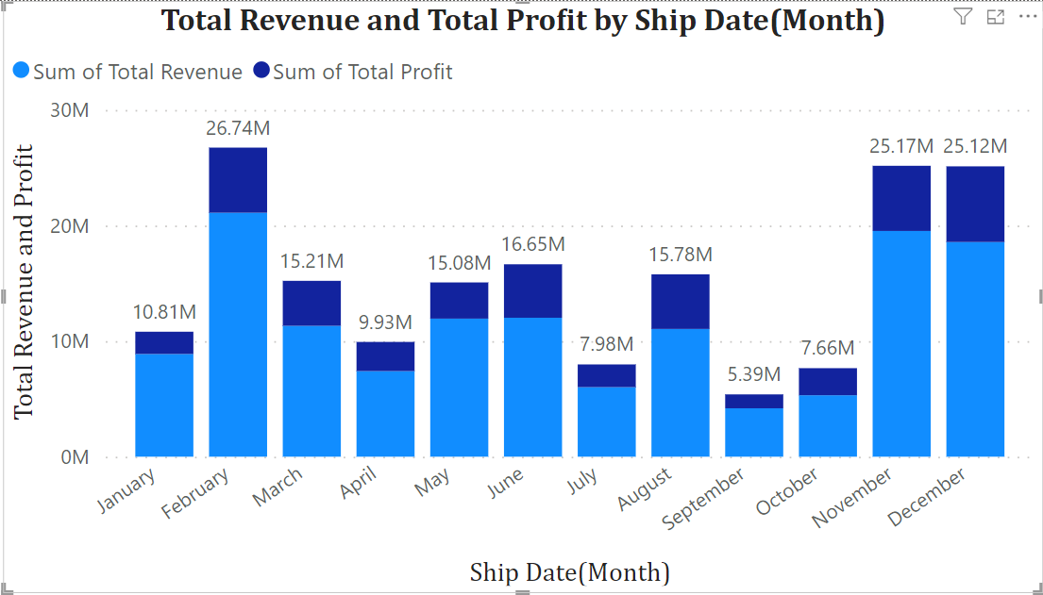

Slide 5
Explanation
February Spike: The significant increase in sales in February could be attributed to several factors, such as Valentine's Day promotions, Presidents' Day sales, or the release of new products. Additionally, February often sees increased consumer spending due to tax refunds in some regions.
November and December Peaks: The substantial spikes in sales during November and December are typical due to the holiday season, including events like Black Friday, Cyber Monday, and Christmas shopping. Consumers tend to spend more during these months on gifts and seasonal items.
Summer Dip: There's a noticeable dip in sales during the summer months (June, July, August) compared to other parts of the year. This could be due to factors such as people going on vacations, spending more time outdoors, or allocating less disposable income to shopping during these months.
January and April Decreases: January and April show lower sales compared to adjacent months. January often experiences a post-holiday slump, where consumer spending decreases after the holiday season. In April, there might not be significant shopping events, leading to a slight decrease in sales compared to surrounding months.
Consistency in March, May, and October: These months show relatively consistent sales figures compared to the other months. There may not be specific major shopping events driving sales during these times, resulting in a more stable trend.
September and October Sales Trends: Sales in September (5.39M) typically decrease compared to the summer months due to factors like the conclusion of back-to-school shopping and a post-summer lull. In October (7.66M), sales see a slight increase as consumers may begin early holiday shopping and retailers introduce fall promotions, although it remains lower than peak sales months.

Slide 6
Sales trend: Year-wise

Slide 7
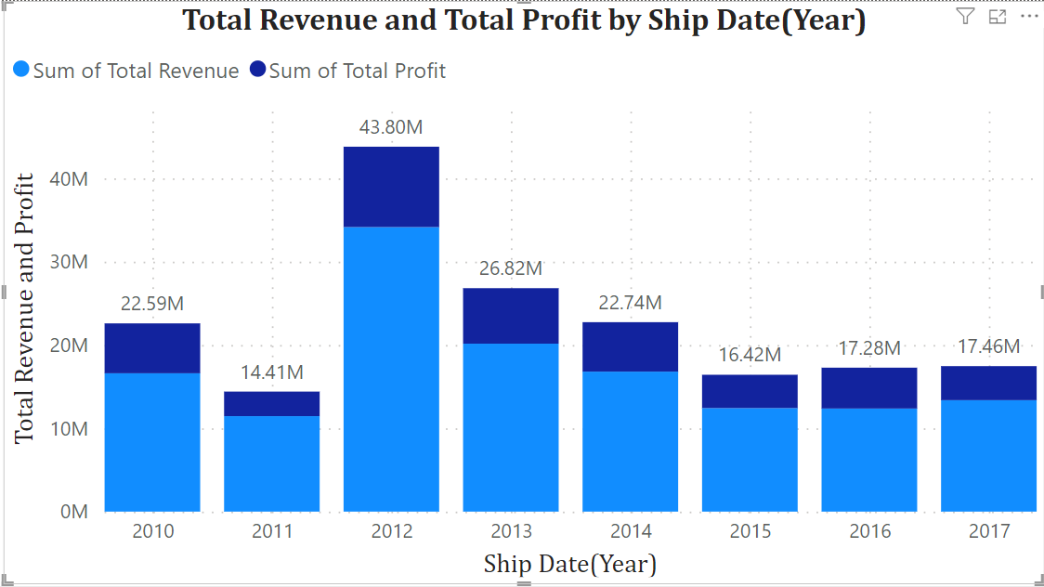

Slide 8
Explanation
Market Expansion (2010-2012): Amazon expanded into new markets, introduced new product categories, attracted more third-party sellers, and expanded its reach globally through aggressive marketing and innovative features like Amazon Prime.
Economic Factors (2012-2015 Decline): Economic downturns and reduced consumer confidence led to lower spending. Increased competition from brick-and-mortar retailers entering e-commerce also impacted sales.
Competition and Market Saturation (2012-2015 Decline): Heightened competition from established and emerging e-commerce players, offering similar products at lower prices, alongside market saturation in certain product categories and regions.
Technological Innovations and Infrastructure Investments (2010-2018): Heavy investments in technology and infrastructure improved operations, reduced shipping times, and enhanced the customer experience with features like one-click ordering and personalized recommendations.
Consumer Behavior Shifts (2012-2015 Decline): Changing demographics and shopping habits, such as the rise of mobile commerce and social shopping, influenced consumer preferences and affected Amazon's sales.
Strategic Initiatives and Diversification Efforts (2015-2018 Stabilization): Amazon diversified its business with initiatives like AWS, Prime Video, and Echo devices, stabilizing sales by broadening revenue streams and offering a wider range of products and services.

Slide 9
Sales trend: Yearly month-wise

Slide 10
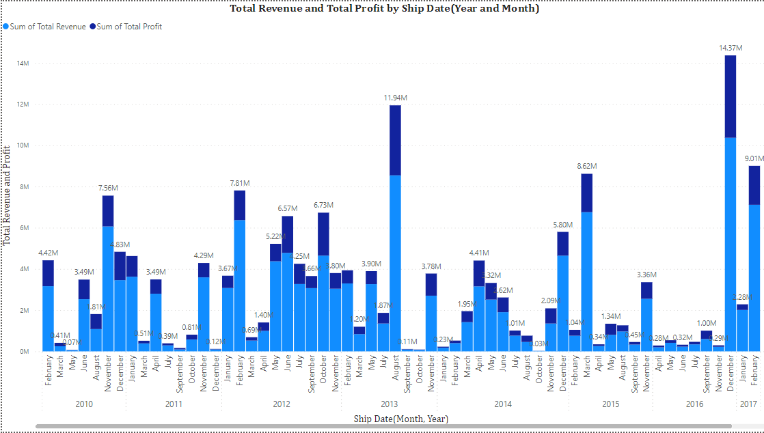


Slide 11
Explanation(from 2010-2013)
2010:
February & June Peaks: Amazon might have launched significant promotions or introduced popular products during these months. Additionally, in June 2010, Apple released the iPhone 4, which could have led to increased sales of accessories and related products on Amazon.
November & December Peaks: These months coincide with Black Friday and Cyber Monday, which are major shopping events in the United States. Amazon likely offered substantial discounts and promotions during this period, driving up sales.
2011:
January Peak: Post-holiday sales and clearance events could have been particularly attractive to consumers looking to make discounted purchases after the holiday season.
November & December Peaks: Again, these peaks align with the holiday shopping season and the prevalence of Black Friday and Cyber Monday sales.
2012:
February & October Peaks: Amazon's Kindle Fire tablet was released in November 2011, leading to increased sales of Amazon devices and related accessories in subsequent months. Additionally, October might have seen heightened sales activity in anticipation of the holiday season.
June Peak: The release of popular books, electronics, or other products might have contributed to increased sales during the summer months.
2013:
August Peak: In August 2013, Microsoft announced a price cut for its Surface Pro tablets, which could have led to increased sales on Amazon. Additionally, back-to-school shopping and promotions likely boosted sales of school supplies, electronics, and dormitory essentials.
November Peak: The holiday shopping season began in earnest in November, with Amazon likely offering significant discounts and promotions.

Slide 12
Explanation(from 2014-2017)
2014:
April & May Peaks: Amazon's Prime Pantry service launched in April 2014, allowing Prime members to purchase groceries and household items with free shipping. This could have contributed to increased sales during these months.
December Peak: Traditional holiday shopping factors likely drove sales, alongside Amazon's own promotional efforts.
2015:
March Peak: Apple unveiled the Apple Watch in March 2015, which could have led to increased sales of related accessories on Amazon. Additionally, spring promotions and deals might have contributed to higher sales volumes.
November Peak: Pre-holiday shopping ramped up, with consumers seeking gifts and taking advantage of Black Friday deals.
2016:
December Spike: Amazon's Echo devices, particularly the Echo Dot, gained popularity during this time, potentially driving increased sales. Additionally, the convenience of online shopping during the busy holiday season likely contributed to the spike in December sales.
2017:
February & June Peaks: Amazon's Prime Day, introduced in July 2015, likely contributed to increased sales during both February and June, as Prime members took advantage of exclusive deals and discounts.
January Peak: The aftermath of the holiday season and returns could have contributed to higher sales volumes as consumers shopped for discounted items.

Slide 13
Thank You

